Slide 1
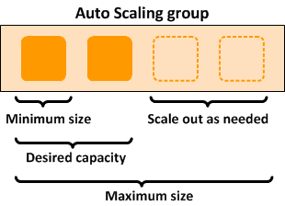
Auto scaling & Elastic Load balancing
Auto Scaling:-
AWS Auto Scaling monitors your applications and automatically adjusts capacity to maintain steady, predictable performance at the lowest possible cost.
Using AWS Auto Scaling, it’s easy to setup application scaling for multiple resources across multiple services in minutes
Amazon EC2 Auto Scaling helps you ensure that you have the correct number of Amazon EC2 instances available to handle the load for your application. You create collections of EC2 instances, called Auto Scaling groups.
Aws auto scaling automatically maintain application performance based on the user requirement at the lowest possible price.
Aws auto scaling is a service which helps user to monitor application and automatically adjust capacity to maintain steady.

Slide 2
Types of Auto Scaling:-
There are 3 types of auto scaling
1)Scheduled Scaling
Scaling based on a schedule allows you to scale your application ahead of known load changes. For example, every week the traffic to your web application starts to increase on Wednesday, remains high on Thursday, and starts to decrease on Friday. You can plan your scaling activities based on the known traffic patterns of your web application.
2) Dynamic Scaling:-
Amazon EC2 Auto Scaling enables you to follow the demand curve for your applications closely, reducing the need to manually provision Amazon EC2 capacity in advance. For example, you can use target tracking scaling policies to select a load metric for your application, such as CPU utilization. Or, you could set a target value using the new “Request Count Per Target” metric from Application Load Balancer, a load balancing option for the Elastic Load Balancing service. Amazon EC2 Auto Scaling will then automatically adjust the number of EC2 instances as needed to maintain your target.
3) Predictive Scaling:-
Predictive Scaling, now natively supported as an EC2 Auto Scaling policy, uses machine learning to schedule the right number of EC2 instances in anticipation of approaching traffic changes. Predictive Scaling predicts future traffic, including regularly-occurring spikes, and provisions the right number of EC2 instances in advance. Predictive Scaling’s machine learning algorithms detect changes in daily and weekly patterns, automatically adjusting their forecasts. This removes the need for manual adjustment of Auto Scaling parameters as cyclicality changes over time, making Auto Scaling simpler to configure.

Slide 3
Benefits of Auto Scaling:-
Better fault tolerance. Amazon EC2 Auto Scaling can detect when an instance is unhealthy, terminate it, and launch an instance to replace it. You can also configure Amazon EC2 Auto Scaling to use multiple Availability Zones. If one Availability Zone becomes unavailable, Amazon EC2 Auto Scaling can launch instances in another one to compensate.
Better availability. Amazon EC2 Auto Scaling helps ensure that your application always has the right amount of capacity to handle the current traffic demand.
Better cost management. Amazon EC2 Auto Scaling can dynamically increase and decrease capacity as needed. Because you pay for the EC2 instances you use, you save money by launching instances when they are needed and terminating them when they aren't.

Slide 4
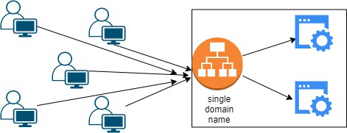
Elastic Load balancing:-
Elastic Load Balancing (ELB) automatically distributes incoming application traffic across multiple targets and virtual appliances in one or more Availability Zones (AZs). Application Load Balancer.
Elastic load balancer is a service provided by Amazon in which the incoming traffic is efficiently automatically distributed across a group of backend servers in a manner that increases speed and performance.
It helps to improve scalability of your application and secures your applications.
Load Balancer allows you to configure health checks for the registered targets. In case any of registered target fails the health check, the load balancer will not route traffic to that unhealthy target. Thereby ensuring your application is highly available and fault tolerant.

Slide 5
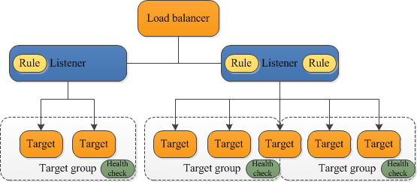
Types of Elastic Load Balancing:-
1)Application Load Balancer:-
A load balancer serves as the single point of contact for clients. The load balancer distributes incoming application traffic across multiple targets, such as EC2 instances, in multiple Availability Zones. This increases the availability of your application. You add one or more listeners to your load balancer.
2)Network Load Balancer:-
A load balancer serves as the single point of contact for clients. The load balancer distributes incoming traffic across multiple targets, such as Amazon EC2 instances. This increases the availability of your application. You add one or more listeners to your load balancer.

